Slide 1

EXPANDING DiCE.Lang to OTHER TARGET GROUPS:
DIGITAL CITIZENSHIP EDUCATION
FOR REFUGEES

Slide 2


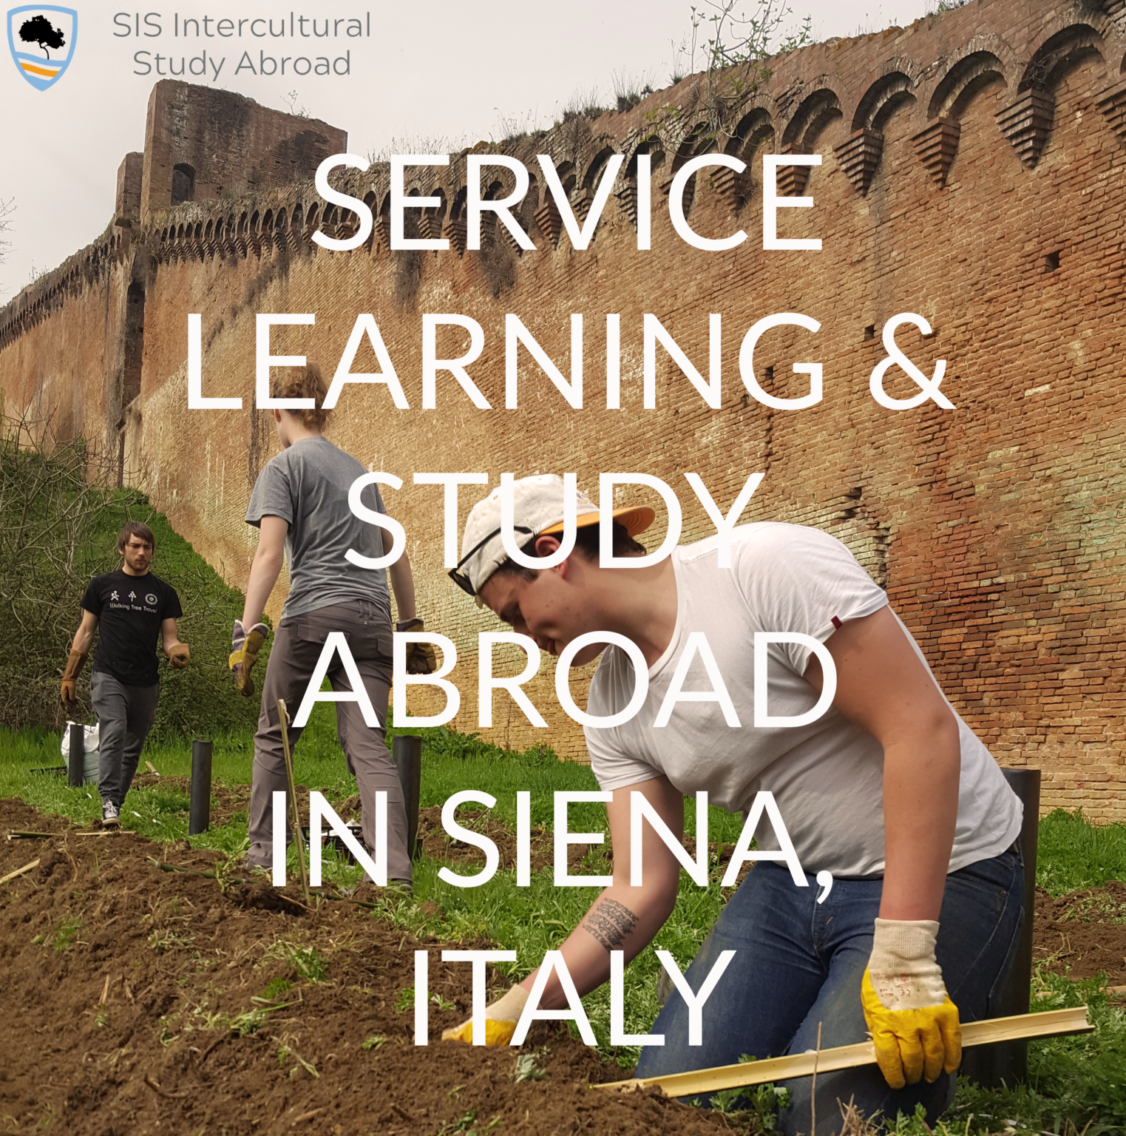

Siena Italian Studies & Nuova Associazione Culturale Ulisse
+
DiCE.Lang Project experience
↓
Digital Citizenship Education
for Refugees

Slide 3
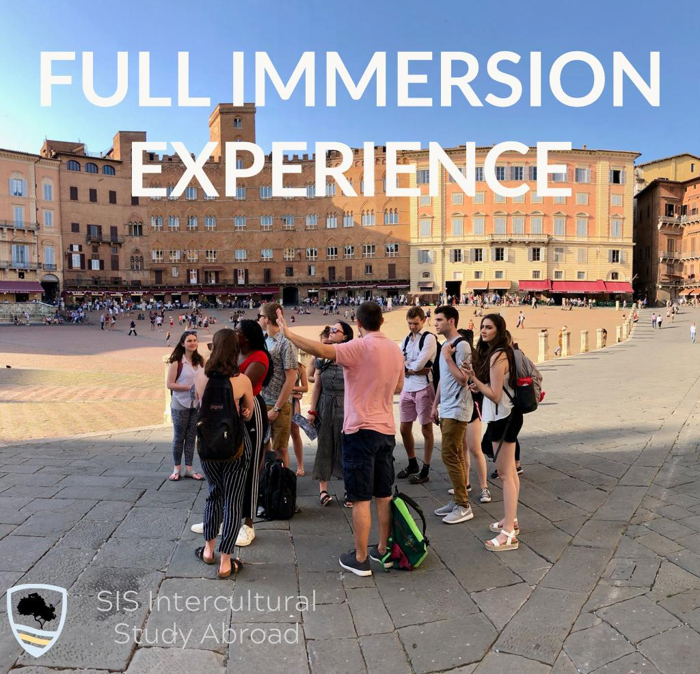
Siena Italian Studies - SIS
SIS is a private and independent study abroad program, it was born in 2004 with the aim of teaching Italian language and culture using the Service-Learning pedagogy.
Since then, SIS has activated many study-abroad program opportunities, expanding its contacts to include students from different geographical areas, extending the network of collaborations with volunteering associations in the local territory, expanding service-learning opportunities for students, giving theoretical substance to the teaching approach used (EUFICCS approach) thanks to the work of teachers, researchers and collaborators.
Notes:
Forse possiamo spiegare brevemente in cosa consiste EUFICCS prima della prossima slide o con la prossima slide?

Slide 4
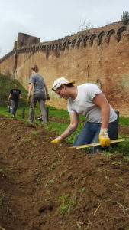
SIS APPROACH
SERVICE-LEARNING
↓
SERVICE
REFLECTION
FULL-IMMERSION
↓
LANGUAGE
CULTURE
DEMOCRATIC COMPETENCES (RFCDC)
↓
ACTIVE AND RESPONSIBLE CITIZENSHIP
DIGITAL CITIZENSHIP EDUCATION (DCE)
INTERCULTURAL SERVICE-LEARNING FOR DEMOCRACY

Slide 5

Nuova Associazione Culturale Ulisse - NACU
NACU is a non-profit association based in Siena, Italy, promoting cultural exchange between visitors and the local community.
Through Service-Learning activities and projects, NACU creates innovative opportunities both for visitors and the Sienese community to share experiences and learn more about each other.
NACU offers Service-Learning activities in the fields of education, healthcare, environmental and heritage preservation, inclusion of migrants and refugees.

Slide 6
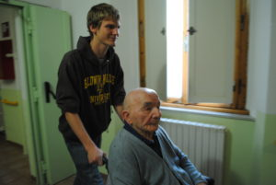
SIS & NACU
In order to fulfill its mission, NACU collaborates with different stakeholders in Siena, such as local public schools, volunteer organizations, local government, business and media.
NACU's main partner is SIS: every year SIS welcomes dozens of international college students, who come to do a study abroad experience in Italy and provide continuative service activities in the local community.

Slide 7
SIS, NACU and Education to Democracy
Since 2016 SIS and NACU have inspired all their work and service activities to the the Council of Europe’s Reference Framework of Competences for Democratic Culture (RFCDC).
The RFCDC provides a comprehensive reference framework covering Education for Democratic Citizenship and Human Rights Education (EDC/HRE) and intercultural education (IE): it is currently being viewed by the CoE as the primary vehicle through which EDC/HRE and IE can be implemented within member states.

Slide 8
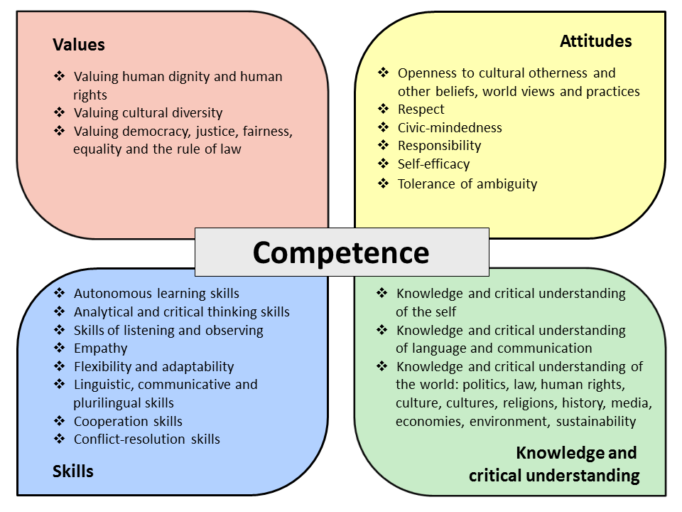
The RFCDC indicates the 20 democratic competences necessary for citizens to live peacefully in a culturally diverse society.

Slide 9
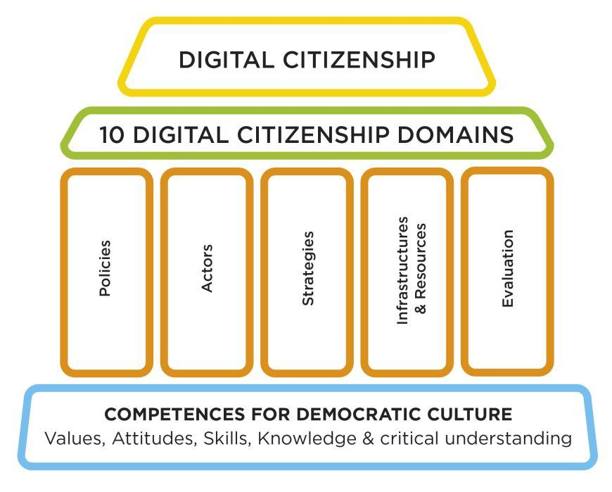
From the RFCDC to the DCE Temple
From real to digital…
Responsible, active and democratic citizenship is not something only related to the real world any longer.
Living our digital/virtual/online life implies exactly the same rights and duties.
For this reason the RFCDC is set at the base of Digital Citizenship Education:

Slide 10

The HOME 4 THE WORLD Project
The Home 4 the World Project was created in Spring 2022 by NACU in collaboration with SIS students with the main goal of assisting refugees and minors from all around the world. It was initially meant as a Help Desk for migrants in need. Very soon it revealed its importance in the territory of Siena and activated some important services.

Slide 11
The Home 4 the World project:
the dream goal is…
an inclusive and culturally diverse democratic society
Ideally, this means that:
equality and equity can be achieved for everyone (nationals, migrants, refugees, etc.);
diversity and differences between social and cultural groups are valued and used as an asset rather than seen as an obstacle;
democratic competences are taught and acquired;
Citizenship Education is (must be) counterparted by Digital Citizenship Education.

Slide 12
The Pakistani emergency
The creation of the H4W Help Desk coincided with an emergency specific to the city of Siena, namely a massive arrival of Pakistani refugees from the Peshawar region, fleeing the occupation of the Taliban regime.
Since the reception system of the province of Siena is not ready for the arrival of such big numbers, there is a real “Pakistani emergency” for the city’s institutions and associations (still going on).
NACU aims at:
1) providing refugees with linguistic tools to facilitate communication both at the local (Italian language) and at global (English language) levels;
2) providing intercultural dialogue and understanding through storytelling, sharing of personal life experiences, cultural beliefs and traditions;
3) developing democratic competences;
4) providing digital citizenship education.

Slide 13
Services provided by Home 4 the World
Support to navigate the Italian legal system: H4W provides migrants and refugees with basic legal information to formalize the asylum application, acquire residence permits, find a lawyer, etc.;
Access to the Italian healthcare system: H4W informs migrants and refugees about its functioning as well as the procedure to receive the Italian health insurance card;
Find an accommodation: migrants and refugees are provided with information about the reception centers and shelters where they will be able to be hosted both before and after the regularization process;
Psychological and emotional support

Slide 14
Services provided by Home 4 the World
Tutoring and intercultural mediation for migrant/refugee minor students in local public schools;
Italian language classes
CV drafting and job counseling
English language classes
Intercultural Education
Citizenship Education classes
Digital Citizenship Education classes

Slide 15
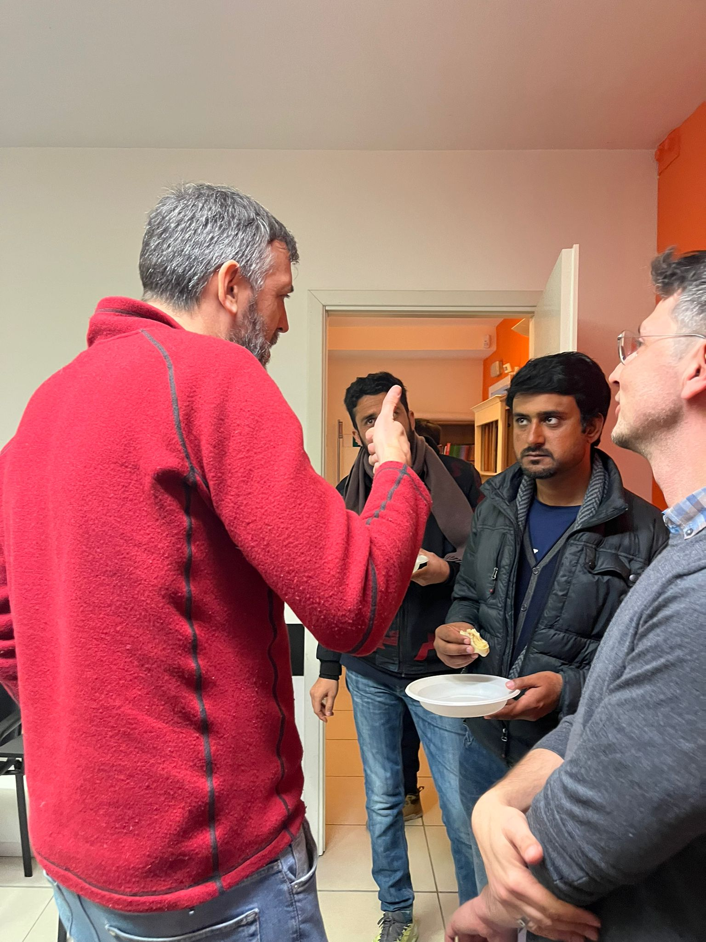
INTERCULTURAL EDUCATION
Together with classes of Italian and English language, SIS offers refugees and international students the opportunity to have a true and deep intercultural exchange.
SIS students offer their time and refugees offer their experience: by telling stories and sharing recreational moments, the two groups mingle and discuss different cultural positions and perspectives in an open, respectful and democratic context.

Slide 16
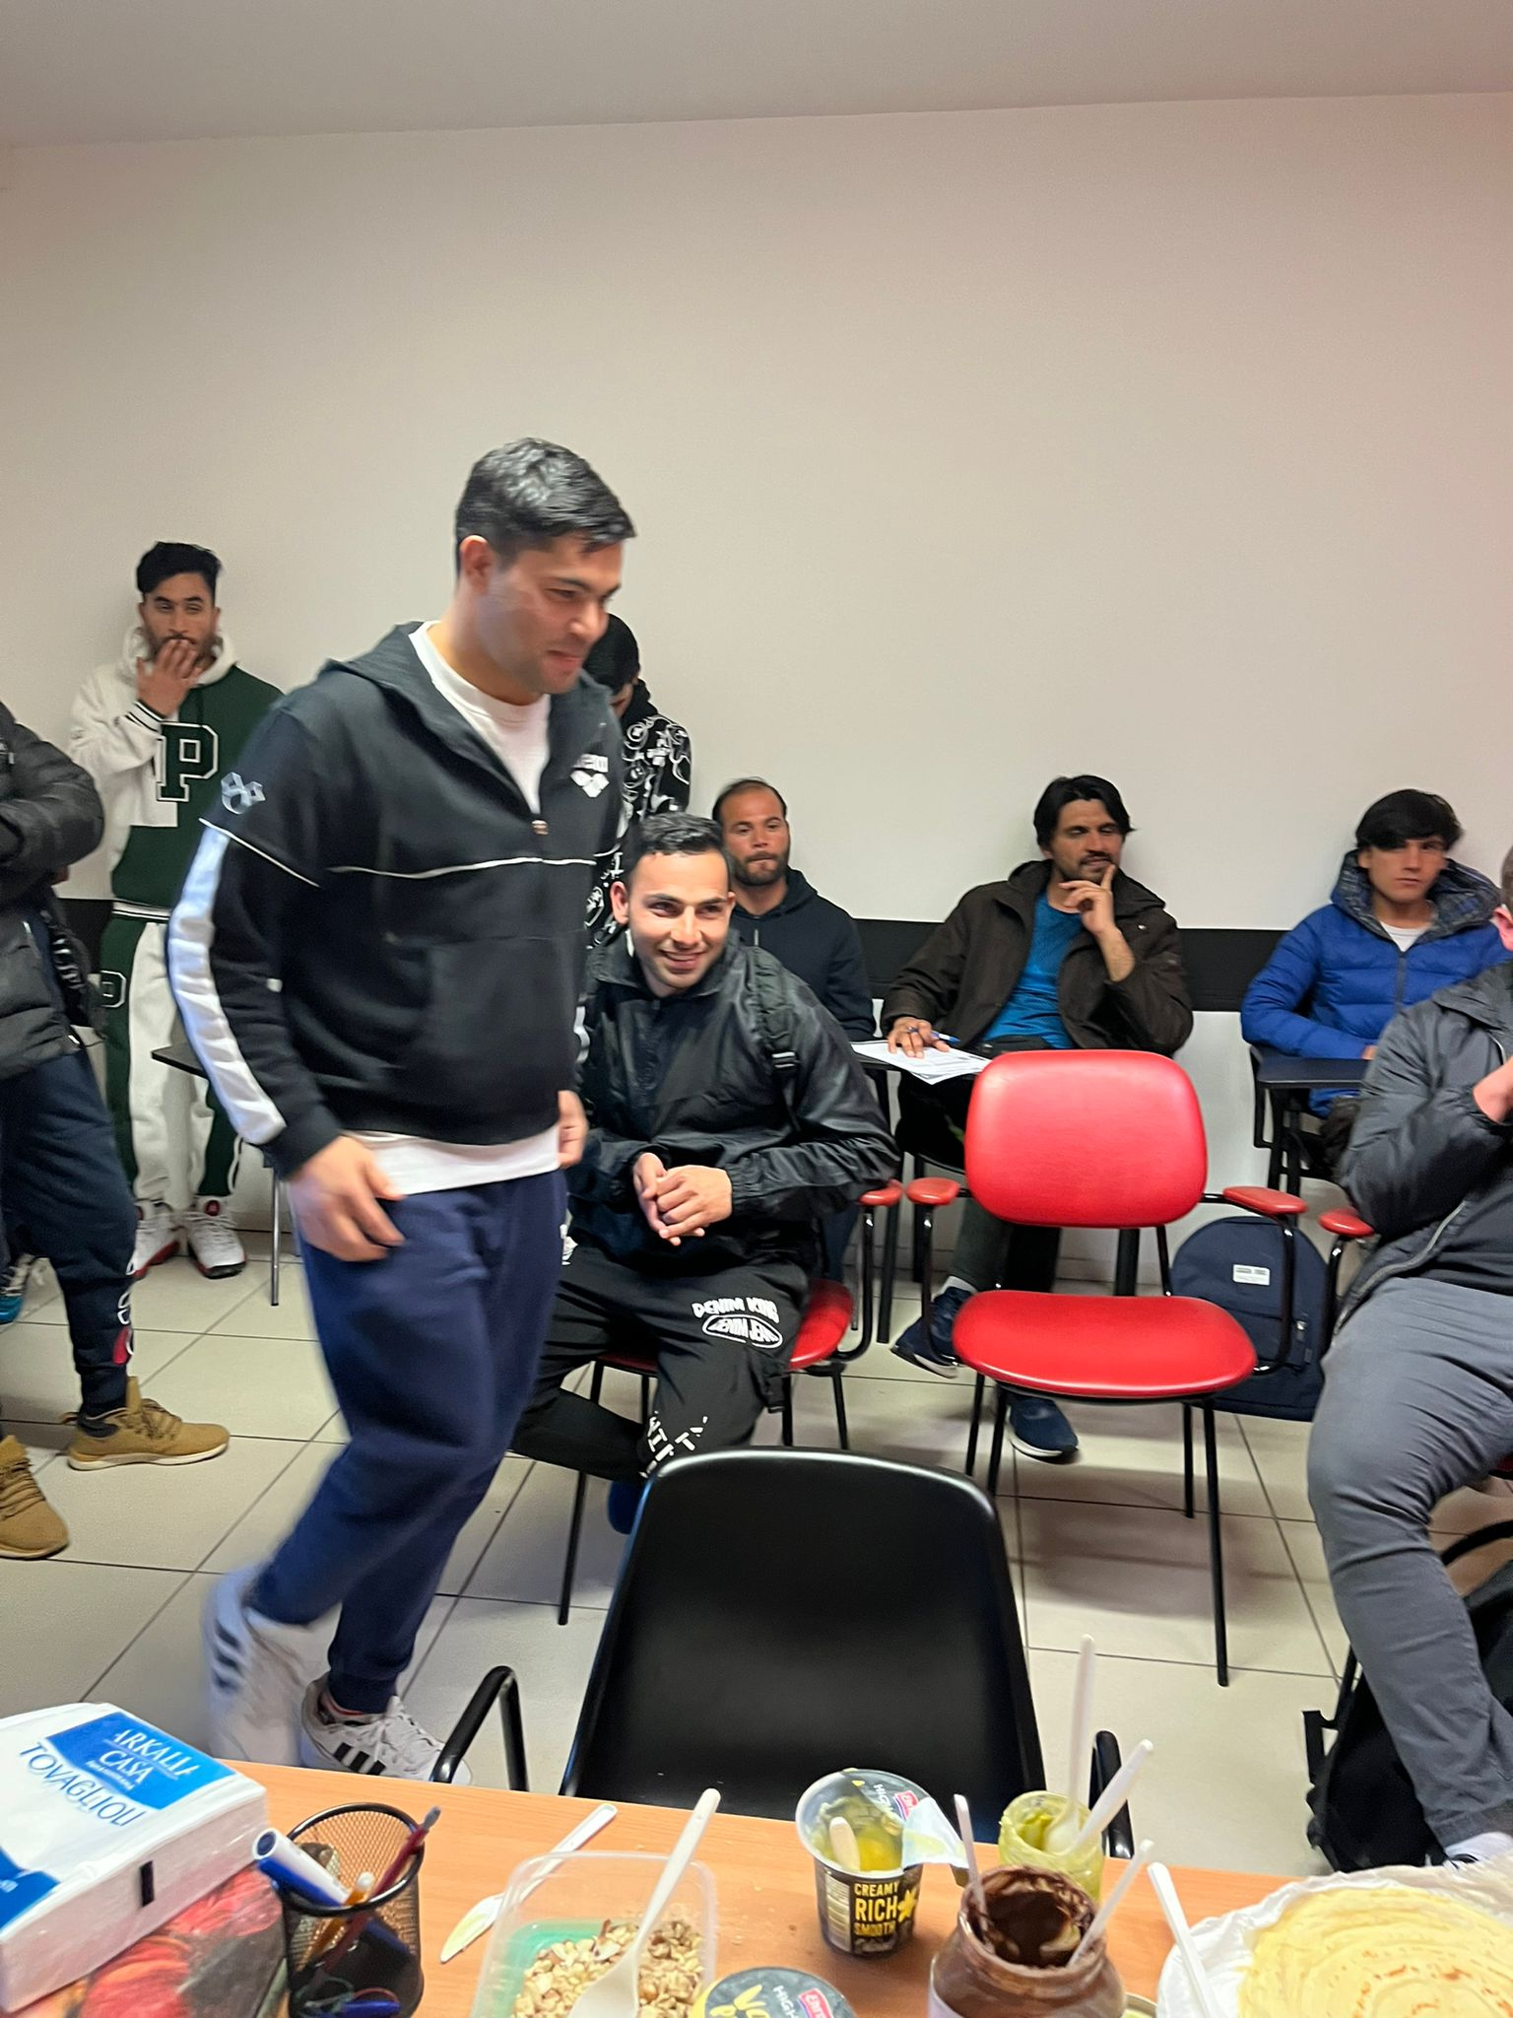
The intercultural exchange can take several forms…
preparing and eating typical dishes
having a tea together
playing sports together
listening to traditional music
singing songs in different languages
reading poetry
reading or recounting narratives
storytelling

Slide 17
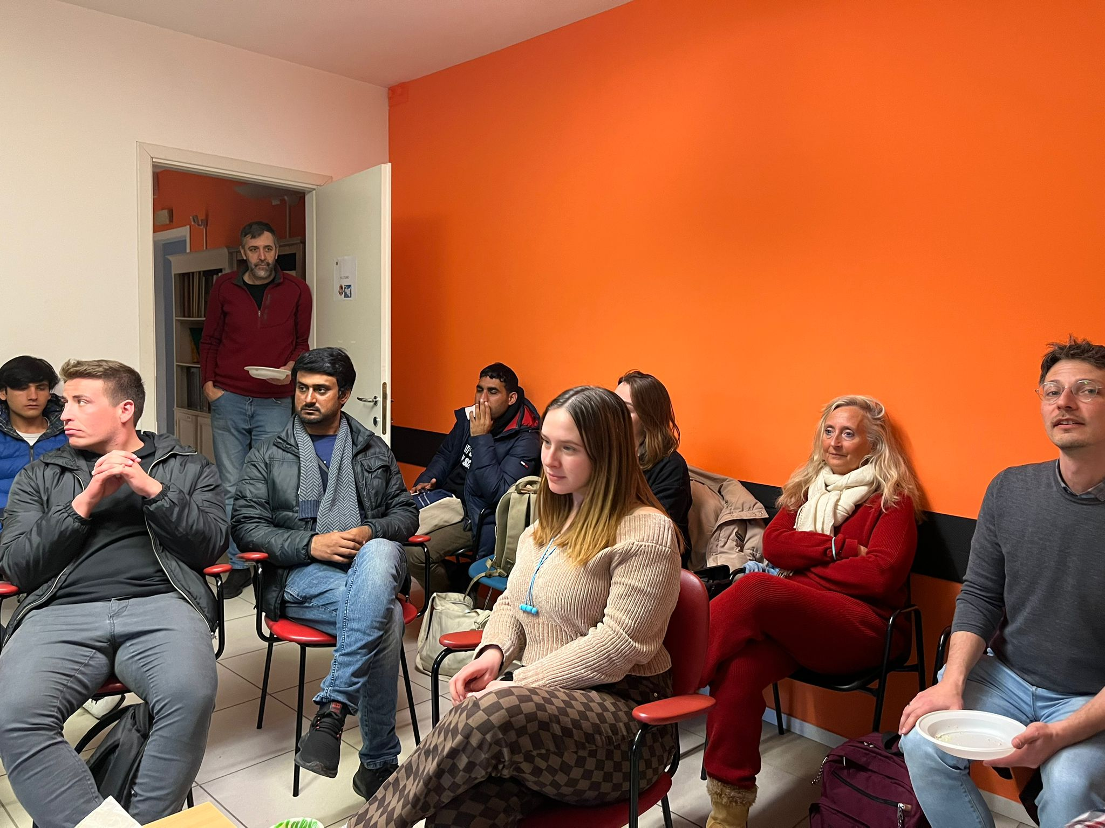
DCE for refugees
Classes focused on education at democracy and DCE happen twice a week for a total amount of 2 hours.
Activities and discussion are shaped
around the RFCDC and
the DCE domains.

Slide 18
DCE for refugees: Work in progress
So far, classes have revolved around the following main themes:
Access and inclusion (Being Online domain)
Media and information literacy (Being Online domain)
Health and wellbeing (Wellbeing Online domain)
E-presence and communication (Wellbeing Online domain)
Active participation (Rights Online domain)
Rights and responsibilities (Rights Online domain)
Privacy and security (Rights Online domain)

Slide 19
DiCE.Lang for refugees: Work in progress
DiCE.Lang OERs, especially the Teaching Units, are valuable and precious tools for DCE classes. So far, some activities were taken by the following DiCE.Lang Teaching Units:
Counter and alternative narratives on hate speech
Refugees and the importance of digital education
Fake identities and fake accounts on social media
Using digital skills to understand and challenge prejudice
The entire units are planned to be used during next semester in a structured course of DCE for refugees.

Slide 20
Food for thought…
How can we re-adapt
the DiCE.Lang OERs
for this new target group?

Slide 21
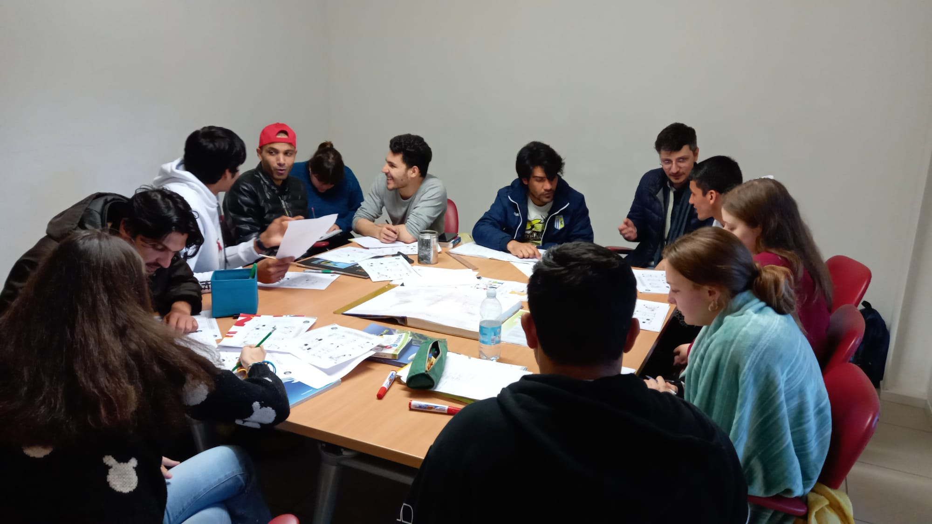

Slide 22
https://www.sisstudyabroad.com/
https://www.nuovaassociazioneulisse.com/
https://www.nuovaassociazioneulisse.com/home-4-the-world/
GRAZIE !!!

